Slide 1
Software Design and Architecture
Domain Model
Sequence Diagrams

Slide 2
Domain Model
A domain model, or Domain Object Model (DOM) is a conceptual model of a domain of interest (often referred to as a problem domain)
which describes the
  various entities,
  their attributes and
  Relationships.

Slide 3
How to represent entities?
A Domain Model is used to represent entities and it illustrates meaningful concepts in a problem domain.
It is a representation of real-world things, not software components.
It is a set of static structure diagrams; no operations are defined.
It may show:
  concepts
  associations between concepts
  attributes of concepts

Slide 4
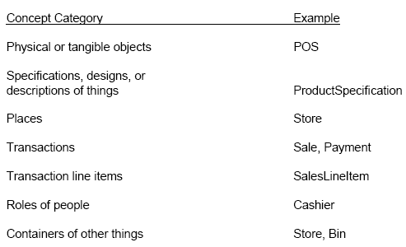
Concept Category List

Slide 5
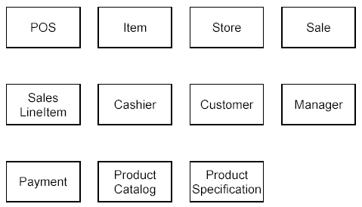
Example: POS

Slide 6
Identify Attributes
An attribute is a logical data value of an object.
For example, a Sales receipt normally includes a date and time.
The Sale concept would need a date and time attribute.

Slide 7
Attributes …
Keep attributes simple.
The type of an attribute should not normally be a complex domain concept, such as Sale or Airport.
Attributes in a Domain Model should preferably be
  Pure data values: Boolean, Date, Number, String, …
  Simple attributes: color, phone number, zip code, universal product code (UPC), ...

Slide 8
Identify Operations
Add operations/method names related to each concept.

Slide 9
Identify Entity Relations
The relationships between the entities identified earlier are known as associations.
An association is a relationship between concepts that indicates some meaningful and interesting connection.
Associations can be named.

Slide 10
Identify Multiplicities
Multiplicity defines how many instances of a type A can be associated with one instance of a type B, at a particular moment in time.
For example, a single instance of a Store can be associated with “many” (zero or more) Item instances.

Slide 11
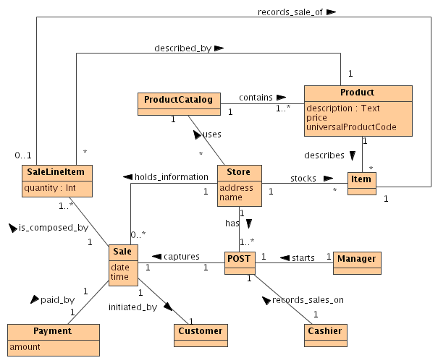
Putting it all together: POS Domain Model

Slide 12
Break

Slide 13
Sequence Diagram
A sequence diagram is a kind of interaction diagram that shows how processes operate with one another and in what order.
The sequence diagram is used primarily to show the interactions between objects in the sequential order that those interactions occur.

Slide 14
Sequence Diagram
The main purpose of a sequence diagram is to define event sequences that result in some desired outcome.
The focus is less on messages themselves and more on the order in which messages occur.
The diagram conveys this information along the horizontal and vertical dimensions:
  the vertical dimension shows, top down, the time sequence of messages/calls as they occur, and
  the horizontal dimension shows, left to right, the object instances that the messages are sent to.

Slide 15
Sequence Diagram – Important Points
Every object has a lifeline that is drawn as a vertically dashed line below it.
Communication between objects is shown by messages between those objects drawn between their lifelines.
Every Sequence Diagram should have an actor object. This actor object is an external stimulus that tells the system to run some functionality.

Slide 16
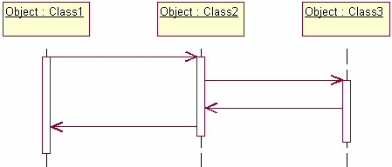
Message1()
[Condition:]
Message2()
Message3()
Message4()

Slide 17
Sequence Diagram Contd..
Lets take the basic flow where, say for e.g.
“Joe withdraws $20 from the ATM”
Objects?
  Card Reader
  ATM Screen
  Joe’s Account
A good way to identify the objects is to examine nouns in your flow of events. Some of the nouns will be actors , some will be objects, some will be attributes of the objects. The noun having some behaviour is an object. The one which is an information is just an attribute.

Slide 18
Sequence Diagram Contd..
Joe withdraws $20 from the ATM (flow of events)
  The process begins when Joe inserts his card into the card reader. The card reader reads the number on Joe’s card, then tells the ATM screen to initialize itself
  The ATM prompts Joe for his PIN.
  Joe enters PIN and the ATM opens his account
  Joe’s PIN is validated and the ATM prompts him for a transaction
  Joe selects Withdraw Money
  The ATM prompts Joe for an amount.
  Joe enters $ 20.
  The ATM verifies that Joe’s account has sufficient funds and subtracts $ 20 from his account.
  The ATM dispenses $ 20 and ejects Joe’s card

